Slide 1
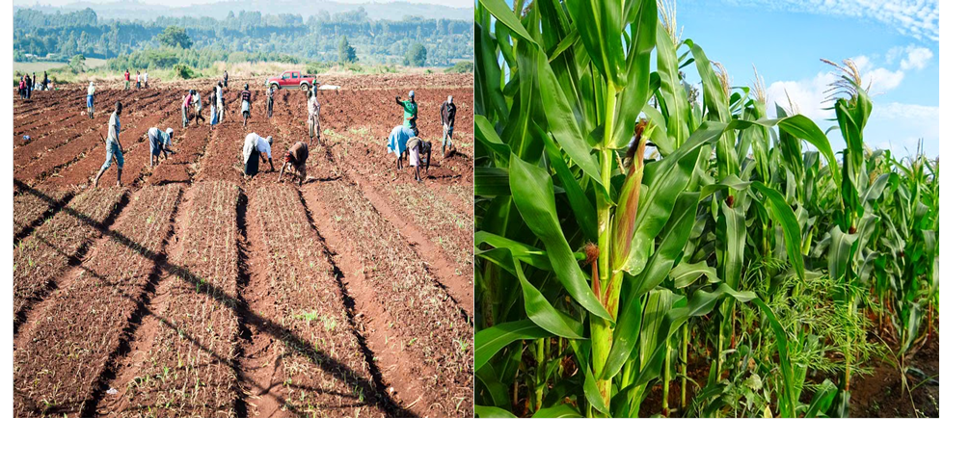

MINISTRY OF AGRICULTURE, LIVESTOCK AND FISHERIES Kenya Cereal Enhancement Programme
Consultancy Services for Development of a Monitoring and Evaluation (M&E) System
Inception Report

Slide 2
Summary of Issues
No. | Key Issue | Addressed
1 | Link method to TOR
2 | Include a chapter on preliminary findings | Included, Chapter 5
3 | Remove IPNI from list of key stakeholders | Pg 33, Table 3.1 on List of key stakeholders and their roles
4 | Stick to KCEP not KCEP CRAL | Captured in Chapter 1
5 | Remove Kenya Seed Company and indicate a general seed company | Pg 33 – Table 3.1
6 | Give a clear idea on MIS | Chapter 2.2.4 of the inception report, pg 24to 31
7 | Change Key implementers to key stakeholders on table 3.1 and indicate roles clearly | Pg 33, Table 3.1
8 | CGA changed to county forums | Pg 33, Table 3.1

Slide 3
Summary of Issues
No. | Key Issue | Addressed
8 | Training venue changed from Nakuru to Eldoret | Pg 36
9 | Timelines- insert a row for deliverables | Pg 38 – Chapter 4
10 | Clarify on the role stakeholders workshop (validation of indicators) | Corrected in pg 33
11 | Review NIMES | Captured Sec 5.3, pg 56
12
13
14

Slide 4
Computerised Management Information System
A management information system (MIS) is a set of systems and procedures that gather information from a range of sources, compile it and present it in a readable format.
In an MIS computerized systems continuously gather data which is then processed, integrated, and stored in a centralized database where it is constantly updated and made available to users.
Key features of a MIS include:
Data Capture
Data Processing
Information Storage
Information Retrieval
Information Propagation

Slide 5
System Options
Option 1
Will involve foregoing the data server development (including related hardware costs).
Anyone with rights of access (username and password) can access the server remotely through the internet.
Will offer ability to edit, view or manipulate stored data depending on the administrative right allocated to the user.
Is based on Google as such the following is required:
Google account
App Engine account
Storage space (Default is 15GB but can be expanded by subscribing to a cloud storage plan)
This option may be the best for projects that are relatively short term and do not necessarily need massive data storage or data archival.

Slide 6
Option 1
Reputable cloud service providers include: Options include: Safaricom Cloud Services, Amazon Web Services, Google cloud, Windows Azure Cloud and Oracle Cloud among others.
Prevailing prices for the Google cloud:
Product | At Rest Pricing | Retrieval Pricing
Standard | $0.026 (GB/Month) | FREE
Nearline | $0.01 (GB/Month) | $0.01 (per GB)
Durable Reduced Availability | $0.02 (GB/Month) | FREE

Slide 7
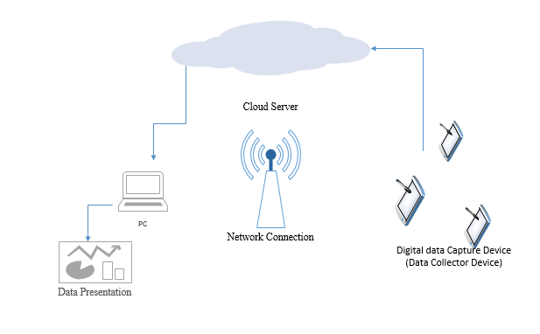
General layout of the Option 1 system

Slide 8
System Options
Option 2
Has some similarity to option 1 but with additional enhancements.
Requires the development of a local server. As such, it comes with the additional costs of setting up and maintaining the server software and associated hardware and accessories.
Components of the system
User Interface | Connectivity
Smart Phone / Tablet interface(The above should be android enabled- KitKat 4.4 and above) - Java and AppInventor for Android Mac/PC interface (Developed with Visual Studio) | Mobile internet (Dial-up, broadband) WI-FI Module and, or Ethernet Application Server (Java, Windows, .NET, PHP)
Data Capture | Storage
Manually (Paper forms, hand notes) Automatic/ Semi-automatic (GPS, digital camera, camcorder, text scanner, barcode scanner, digital voice recorder) | Cloud Storage and backup Local Storage and backup in a local server connected database (Oracle or MS Access)

Slide 9
Data capture module:
The data capture module will feature sub-modules that will enable stakeholders to feed data into the system, i.e.:
Farmer Interface
Service provider interface (i.e. agro-dealers, e.t.c)
Programme staff interface
Equity Bank interface
Others
Farmer Biometric Data
Name
National ID. No
Farm Inputs
Seeds
Fertiliser
Farmer Training Tracker
A list of training sessions attended
Feedback Tracker
Age
Gender
Location
Feedback on quality of services, inputs and complaints

Slide 10
Option 2
Data Processing | Information Retrieval and Propagation
Data processing will involve the development of an application to call 3rd party application to perform specific functions. These include: Office package (MS Excel) Google Spreadsheets Google Earth & Maps GIS applications (ArcGIS) Statistical packages (SPSS, R) Graphing applications (GNU Plot, GNU Octave) Reporting applications (GNU Enterprise, jsreport) Or any other data processing software which can read XLS, CSV, ZIP, KML, SAV ZIP, CSV ZIP, Google docs or XLS reports | Application export functionality in acceptable data formats (.xls, .csv, .zip, .kml/ .kmz, .sav, .accdb, .mdb, .dbf) Sharing of exported files via email or url paths Production of hard copies of the exported files

Slide 11
General layout of the Option 2 system

Slide 12
Some other technical considerations for each system
System Security: involves the protection of information systems from theft or damage to the hardware, the software, and to the information on them, as well as from disruption or misdirection of the services they provide.
We will incorporate the following mechanisms while developing the system to eliminate system vulnerabilities and protect against attacks:
Proposing physical access control mechanisms
Multi-level user authentication (using usernames, passwords, verification codes and prevention of password saving)
Enforcing secure passwords
Encrypting passwords
Firewalls
Enabling integration with antivirus programs
Secure coding
Installation of user certificates

Slide 13
Some other technical considerations for each system
System Testing: Testing provides an objective, independent view of the software to allow the business to appreciate and understand the risks of software implementation. We will conduct testing at two levels:
System Deployment: System deployment includes all of the activities that make a system available for use. Deployment activities include;
Deployment Packaging (Executable file, Install wizard, Help files, License agreement & User keys, Libraries (Fonts, Icons, Languages, Customization files))
Installation & Activation
Periodic Maintenance
Level | Activities | Product
Alpha Level | Internal verification tests by the system developers | Alpha release for testing at the beta level
Beta Level | External user acceptability and functionality validation tests at the field The alpha release will be deployed to sampled users in the selected Counties | Beta release that will be compiled and deployed to the client sites

Slide 14
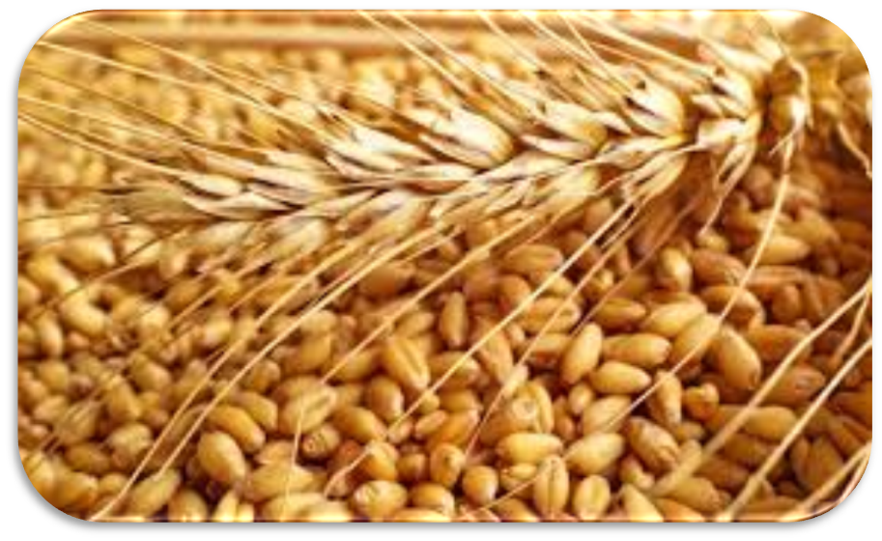
THANK YOU

